Slide 1
Lesson Planning
*hopefully* reducing stress
Amie Felton - Subject Tutor in Psychology and Health and Social Care
Bethany Myland - Subject Tutor in Biology

Slide 2
Why lesson planning is stressful….
I have no resources for this topic as I haven’t done it before
All of my students are at different places or have different abilities
It takes soooooooooo long!
I’m not sure how long each task/topic will take
I need to eat and sleep…..

Slide 3
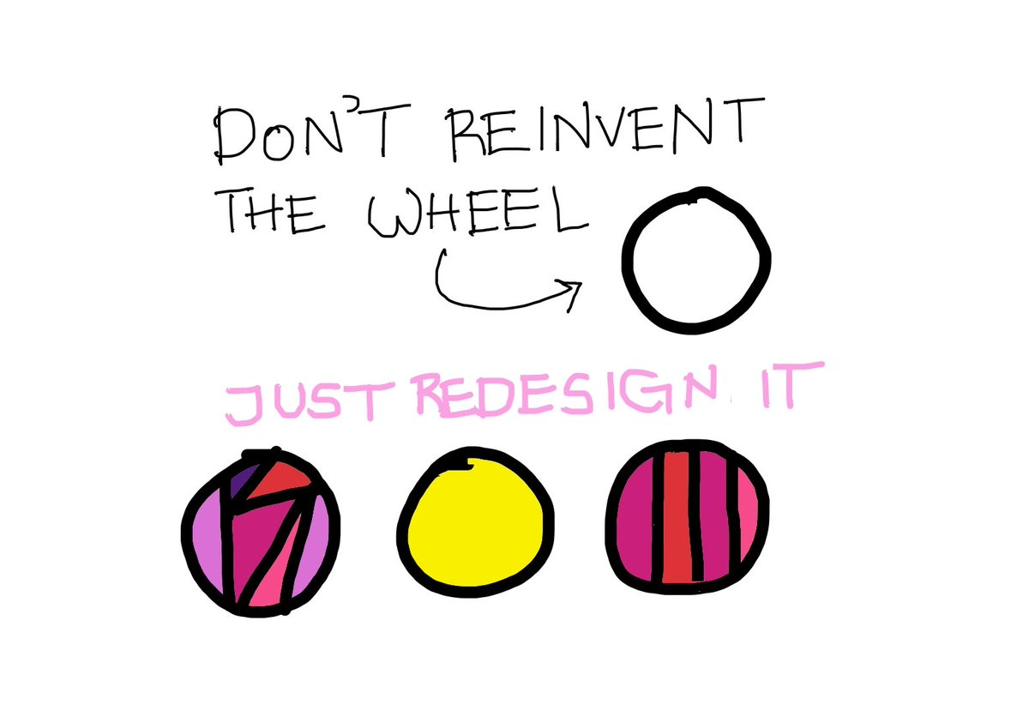
I have no resources for this topic as I haven’t done it before
Ask for Resources!
Within your department or even within these sessions are teachers who will have resources on what you’re looking for….
This way it can just be redesigned to your teaching style
You can’t make all your resources for yourself in your first year (you won’t have time) so just ask - there will be plenty of chances to repay the favour in the future!

Slide 4
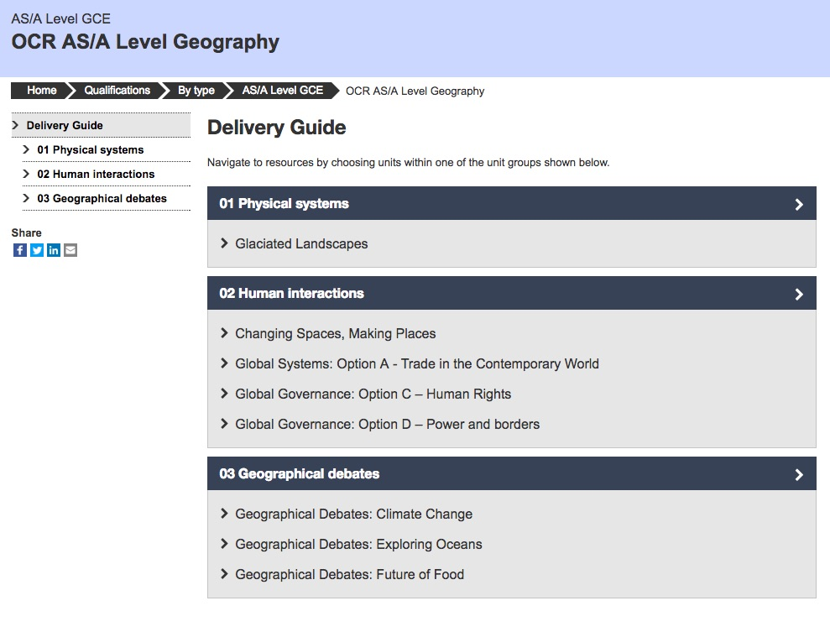
I have no resources for this topic as I haven’t done it before
Check the textbook!
Often these have great activities or reference to real life examples
Check the specification!
Often the exam board publish delivery guides (OCR) and teaching resources (AQA) online

Slide 5
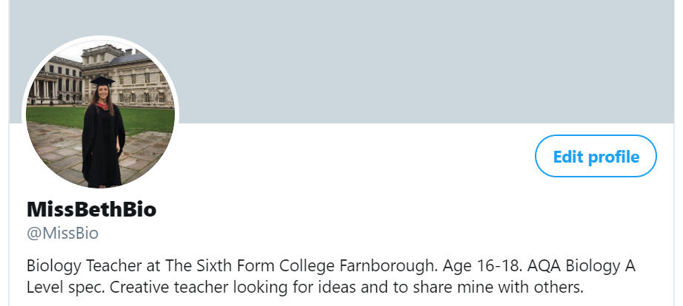
I have no resources for this topic as I haven’t done it before
Get on twitter!
Twitter is the new up and coming way for stealing ideas and resources for teachers.
There is some great stuff on there and people are sharing it for a reason - because it’s worked well!
https://twitter.com/missjmbooth

Slide 6
2) All of my students are at different places or have different abilities
Use some quick techniques that you don’t have to plan for in order to ensure everyone can access and be challenged by the content

Slide 7
High Ability students can...
Explain this to your peer
Make up (and answer) an exam question to check understanding on this
Create a revision poster/flashcard
Relate topic to something we’ve done previously
Evaluate the topic
Relate topic to something in real life
Do some research into background or harder examples

Slide 8
Low Ability can...
Look at real life examples to demonstrate
Have definitions of some of the key terms
Have a worked example on a whiteboard
Have small targets to build up to aim of lesson
Have a buddy to help explain things to them
Look at peer work (from previous year or other class)
Make a storyboard outlining the content
Make a step by step flashcard or poster

Slide 9
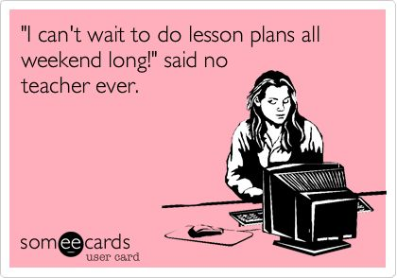
3) It takes soooooooooo long!

Slide 10
3) It takes soooooooooo long!
Get organised to make it easier for your future self
Keep your resources for the future - this makes planning the following year twice as quick!
Record what worked well and what didn’t - then the following year you can improve the things that didn’t work but stick to the things that did work (without planning)

Slide 11
3) It takes soooooooooo long!
The wall...
You might find you hit a point where it all seems a bit too much and overwhelming - you have hit ‘the wall’
Break down what seems like a mountain of tasks into small achievable tasks on a to do list (the bricks) and it will then seem much easier to tackle the wall by ticking one thing off at a time

Slide 12
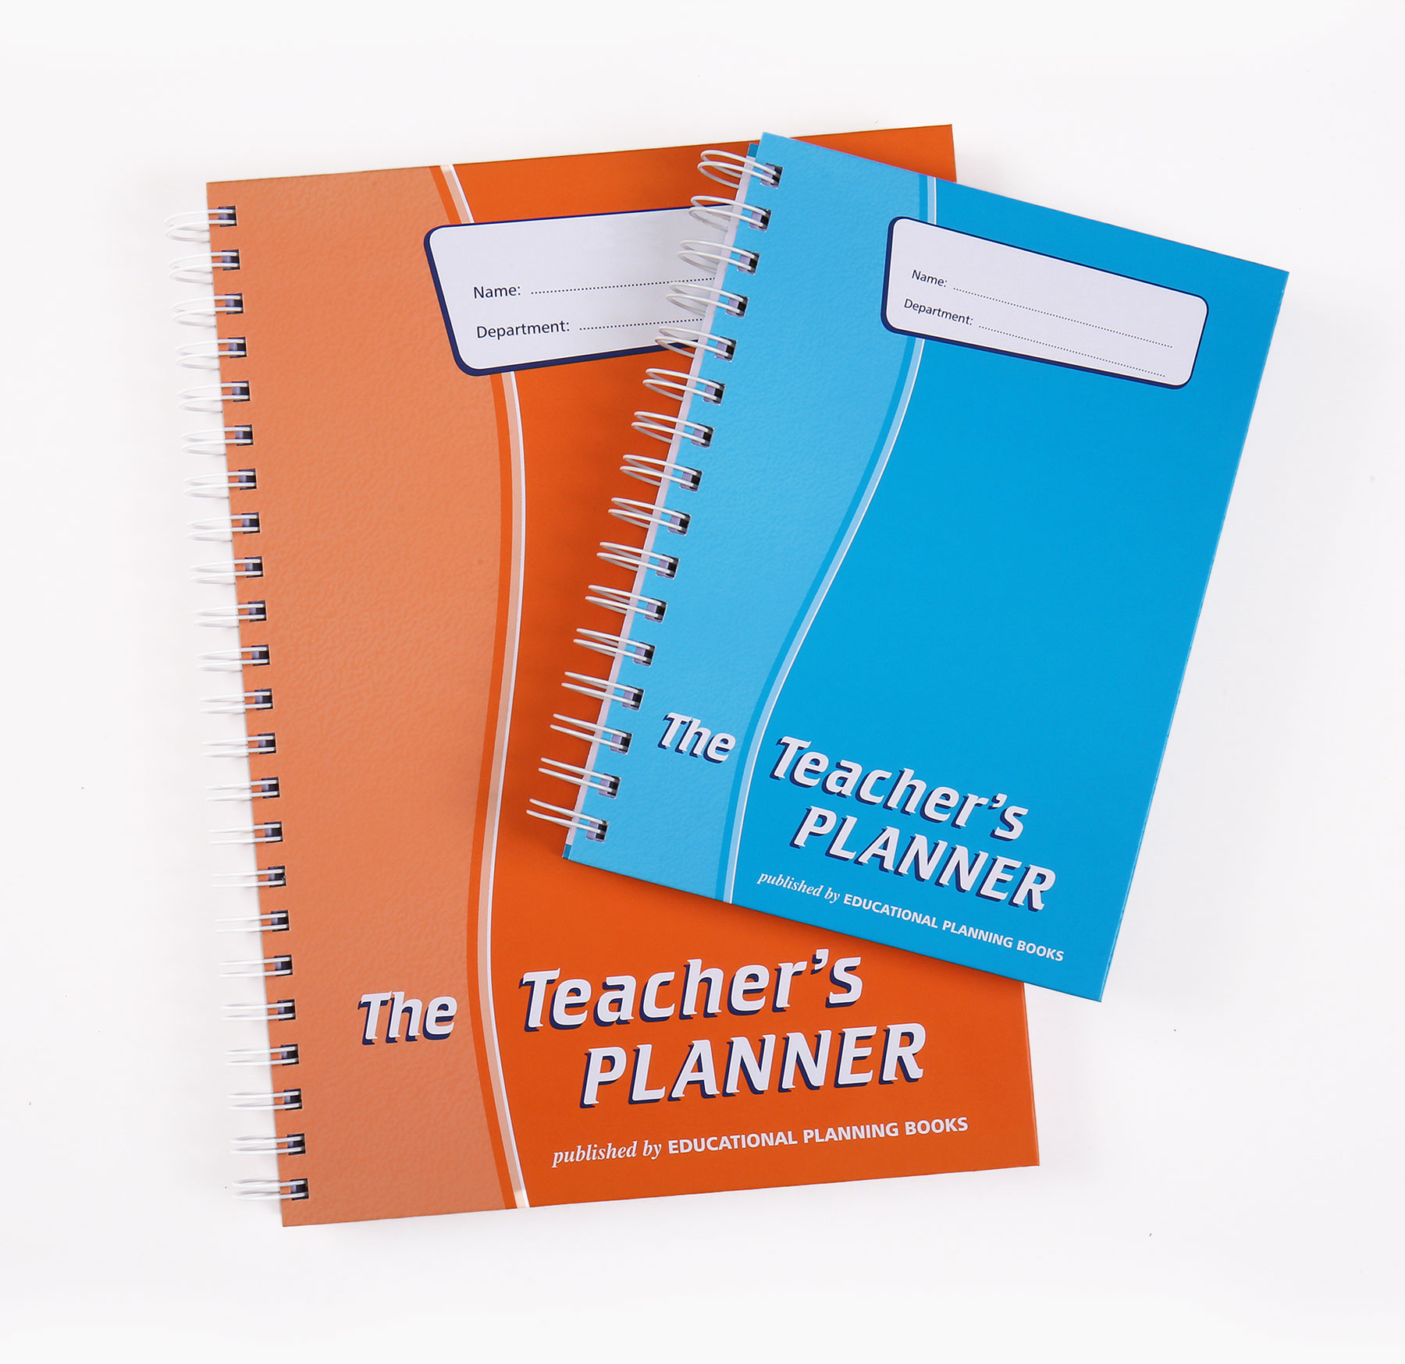
3) It takes soooooooooo long!
Manage your time to manage your stress levels
Plan ahead! - Use a planner/diary to plan what you’re going to teach when (helps to know what’s coming up)

Slide 13
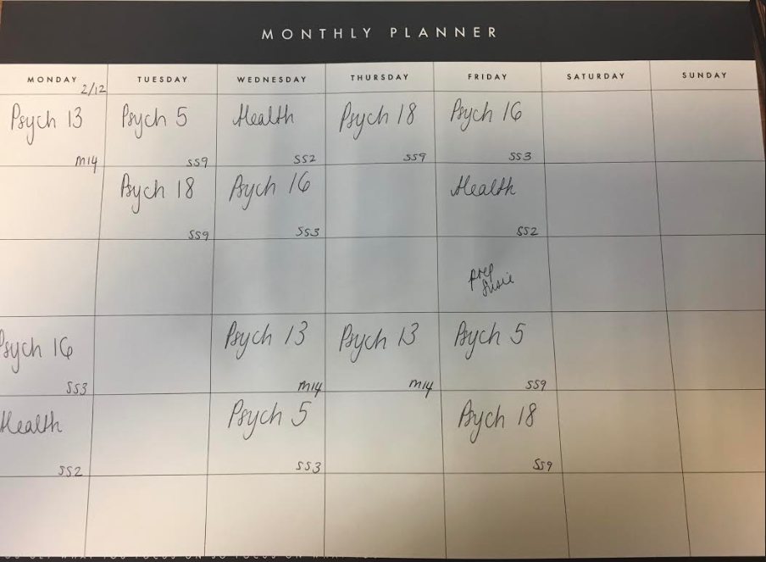
Desk Pad
Get a desk pad/ calendar with 6 slots a day
You can plan your lessons, lunchtimes and after school meetings
This way it is easily viewable for when you’re in a rush

Slide 14
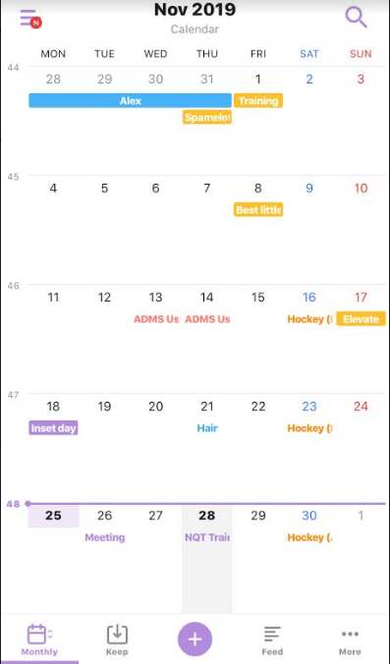
Time Tree
This is an app that lets you have shared calendars (like google calendars)
You can add things within the Scheme of Work, marking deadlines etc.
Perhaps use this with you curriculum area?
Or share with family and friends so they know when you are going to be STRESSED
Notes:
OMG I LOVE THIS APP!

Slide 15
3) It takes soooooooooo long!
Manage your time to manage your stress levels
Have a daily/weekly to-do list - when something pops up add it to to-do list because you WILL forget
As a teacher, you are trying to remember and juggle a million and one things - so write them down!
Plus it is super satisfying ticking them all off

Slide 16
3) It takes soooooooooo long!
Manage your time to manage your stress levels
Post-it notes are great for prioritising tasks in your diary because you can move them about if priorities change

Slide 17
3) It takes soooooooooo long!
Learn that everything can’t always be perfect - there will always be more you can do to improve
So set limits and know when you’ve done enough
Accept that you will have bad lessons as well as good lessons - it happens to us all!
Don’t give up - you learn the most from the bad lessons
Some things you can’t change - only focus on what’s within your control

Slide 18
3) It takes soooooooooo long!
Marking
It is so easy to let marking take over your life….
But is it benefitting students?
Feedback needs to be in a form that benefits students so they can improve

Slide 19
Types of Marking
Peer and Self Marking are always an option!
Not only does it save you time but also gets students familiar with exam technique and mark schemes
This will help them identify what the exam board is looking for
Students are surprisingly mature when it comes to this!

Slide 20
Types of Feedback
WWW and EBI

Slide 21
Types of Feedback
Screen Recordings

Slide 22
Types of Feedback
Model Answers

Slide 23
Types of Feedback
Peer Answers (socrative)

Slide 24
Types of Feedback
Traffic Lighting

Slide 25
4) I’m not sure how long each task/topic will take
It is okay to go off lesson plan!
Also it’s good to do some medium term planning and have a more fluid plan… This way you can ensure you are working to the pace of your students as well as working towards the scheme of work

Slide 26
4) I’m not sure how long each task/topic will take
Lesson Structure
Starter
Main activity
Plenary
Having starters and plenaries up your sleeve make this a lot easier and less time consuming!

Slide 27
4) I’m not sure how long each task/topic will take
Starters
Try and think of things that allow students to come in late without disruption
Write down as much as you can that you already know about…….
Vocab/key word Tests
Define these terms
Impossible questions (give them a sneak peek of what they will learn in the lesson and identify possible misconceptions)
Recap questions to see what they can remember from the previous lesson
Wheel of Doom questions

Slide 28
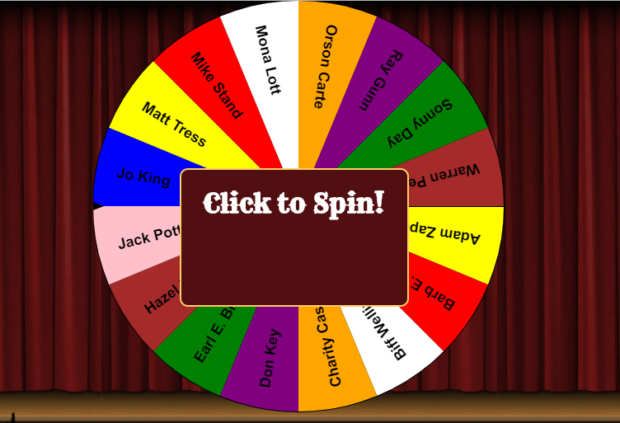
Wheel of Doom
https://www.classtools.net/random-name-picker/
Classtools.net has a name picker where you can save classes
Then students can be picked once or multiple times!
Also can help students focus so they don’t repeat what someone else has said

Slide 29
4) I’m not sure how long each task/topic will take
Plenaries
Relate this news article to what we did today
Think of a real life example of what we spoke about today
Past Paper Question
Write down 3 things you learned today that you didn’t already know
Exit Tickets
Mini whiteboard quiz
Kahoot
Prison break/3 questions for freedom

Slide 30
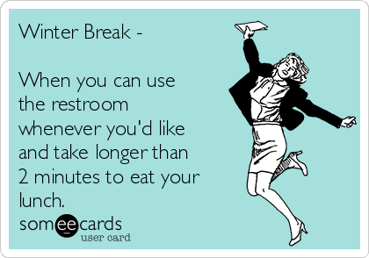
5) I need to eat and sleep….. AND SO YOU SHOULD!
Have a proper lunch and stay hydrated to keep you going through the day - you’ll be surprised how much energy you use being on your feet and teaching all day
Don’t stay up all night planning for the next day - make sure you get enough sleep - you’ll be a better teacher the next day
EMAILS
We can honestly say it gets easier and quicker each year as you’ve got a bank of plans and resources
Don’t feel guilty taking the evening/weekend off
Make sure you use your holidays to do something nice/relax… you honestly will need it!

Slide 31
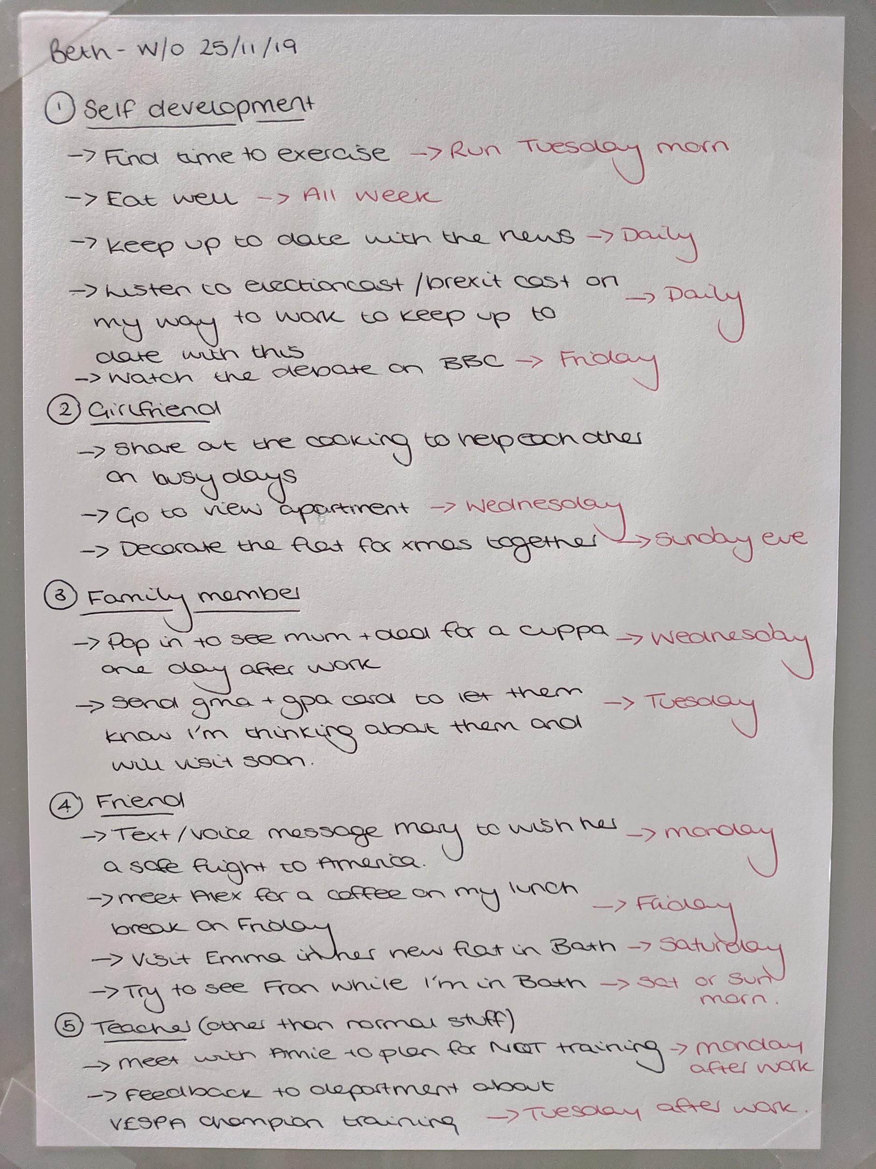
Something I do on a Sunday night each week ...
Teaching is one of those jobs that can take over if you aren’t careful…
Plan other things into your week that are important to you by thinking of your other roles in your life besides being a teacher (eg. a partner, a parent, a sibling, a friend)
Actually plan when you are going to do these things to make sure you make time for them

Slide 32
Time Tree
Try and do at least 1 thing a week FOR YOU
You can also colour code it so you can see when you are working TOO MUCH
There should be an equal balance of each colour for each role you have
Notes:
OMG I LOVE THIS APP!

Slide 33
Thanks for Listening
Any questions?
afelton@farnborough.ac.uk
bmyland@farnbrough.ac.uk

Slide 34
Reflection….

Slide 35
Reflection….
Something you are doing well

Slide 36
Reflection….
Something you are doing well
Something you want to work on

Slide 37
Reflection….
Something you are doing well
Something you want to work on
Someone you’re going to ask for help

Slide 38
Reflection….
Something you are doing well
Something you want to work on
Someone you’re going to ask for help
Something you are going to use that’s been covered today

Slide 39
Reflection….
Something you are doing well
Something you want to work on
Someone you’re going to ask for help
Something you are going to use that’s been covered today
Something you’re going to do for YOU next week

